Slide 1
university success analysis
Capstone Project
Shivam Upadhyay

Slide 2
Objective
Microsoft
powerbi
University success ANALYSIS
To analyze and understand the determinants of university success, our capstone project aims to uncover key variables impacting academic achievement. Through insightful data analysis, our presentation will highlight actionable findings, providing a foundation for informed strategies to enhance overall university success.

Slide 3
Analysis scope
Microsoft
powerbi
University success ANALYSIS
The analysis scope of our capstone project on university success encompasses a comprehensive examination of various factors influencing academic achievement. The scope extends to the creation of a detailed dashboard, visually presenting the correlations and patterns discovered during our analysis.

Slide 4
Goal
Microsoft
powerbi
University success ANALYSIS
The primary goal of our university success analysis project is to translate our findings into a dynamic, user-friendly dashboard. By seamlessly integrating data visualization with actionable insights, our goal is to contribute to the creation of a supportive and enriching academic environment.

Slide 5
Insights and recommendations
Microsoft
powerbi
University success ANALYSIS
It provides a real-time visual representation,
aiding decision-makers in identifying trends
and to create an environment that not only
promotes academic achievement but also
supports the holistic development of
students.

Slide 6
Power bi dashboard
microsoft
University success ANALYSIS
powerbi
Our Power BI dashboard visually represents insights derived from data analysis. Dynamic charts, graphs, and heatmaps showcase patterns, correlations, and trends, empowering stakeholders to grasp complex information at a glance.

Slide 7
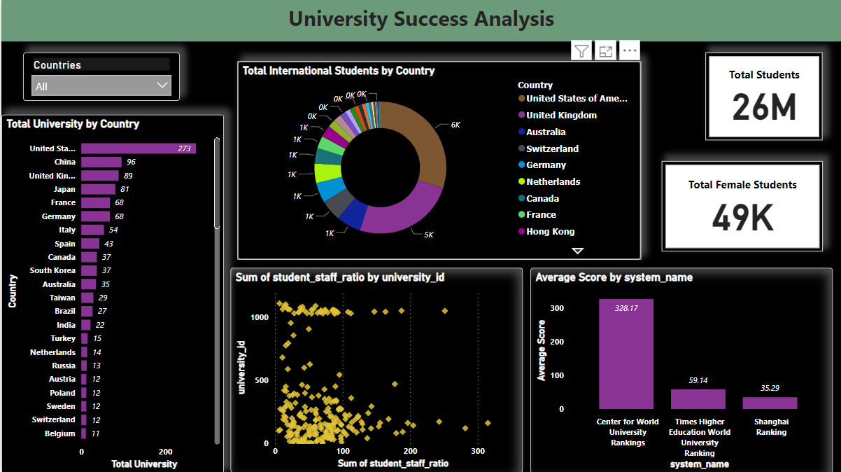
POWER BI DASHBOARD
University success ANALYSIS

Slide 8
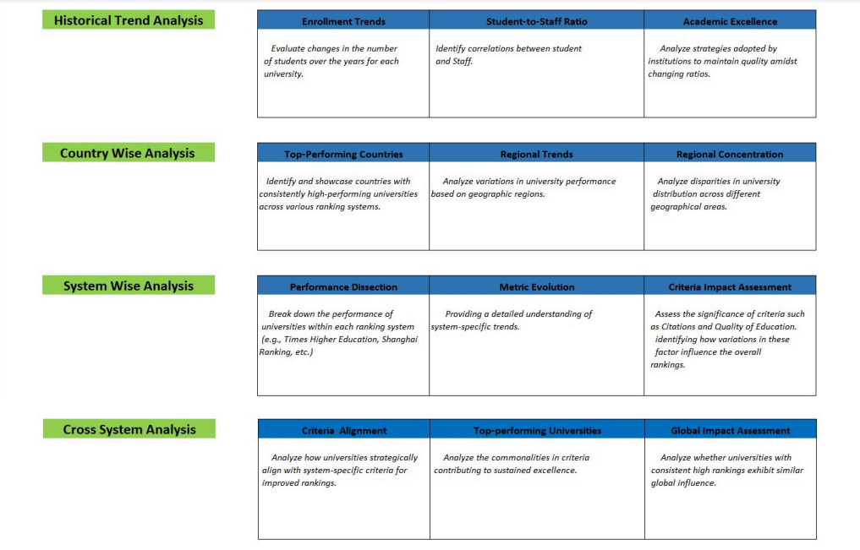
MECE Breakdown
University success ANALYSIS

Slide 9
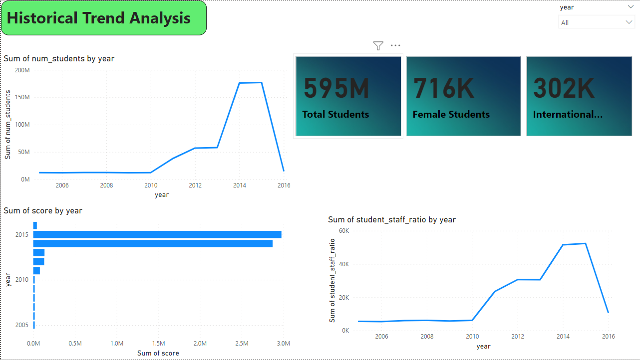
DASHBOARD
University success ANALYSIS

Slide 10
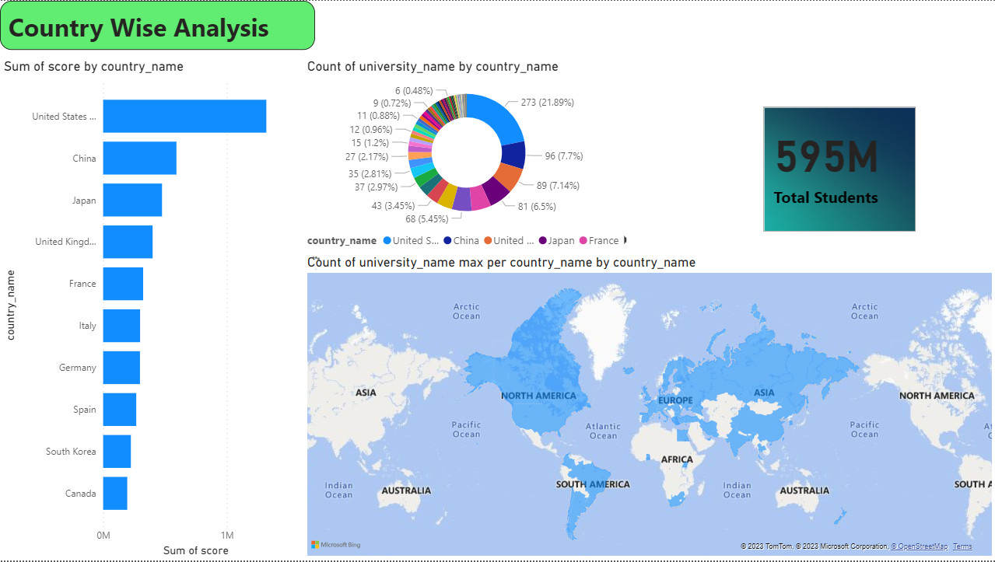
DASHBOARD
University success ANALYSIS

Slide 11
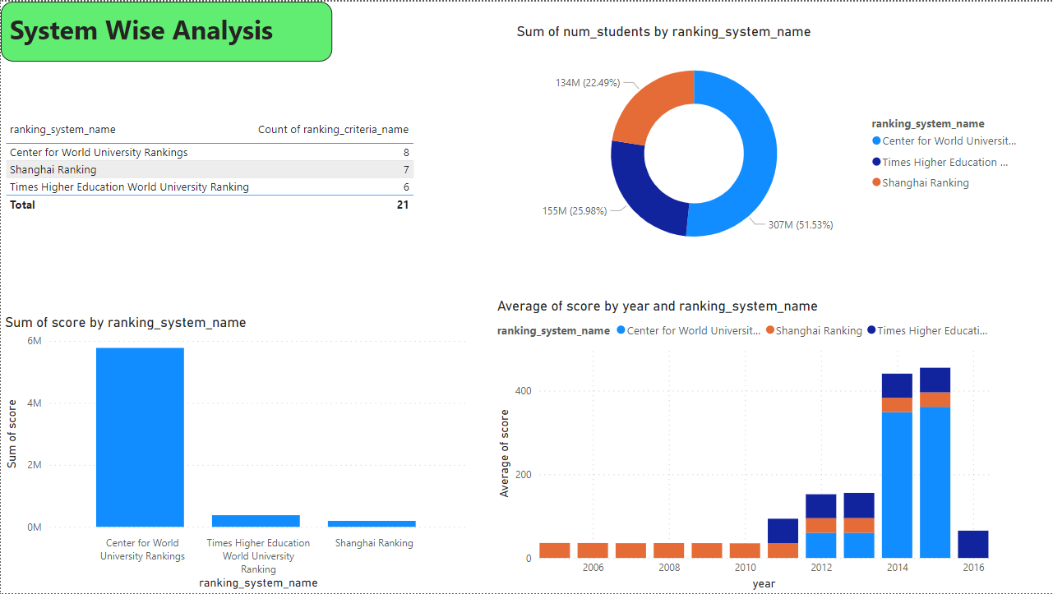
DASHBOARD
University success ANALYSIS

Slide 12
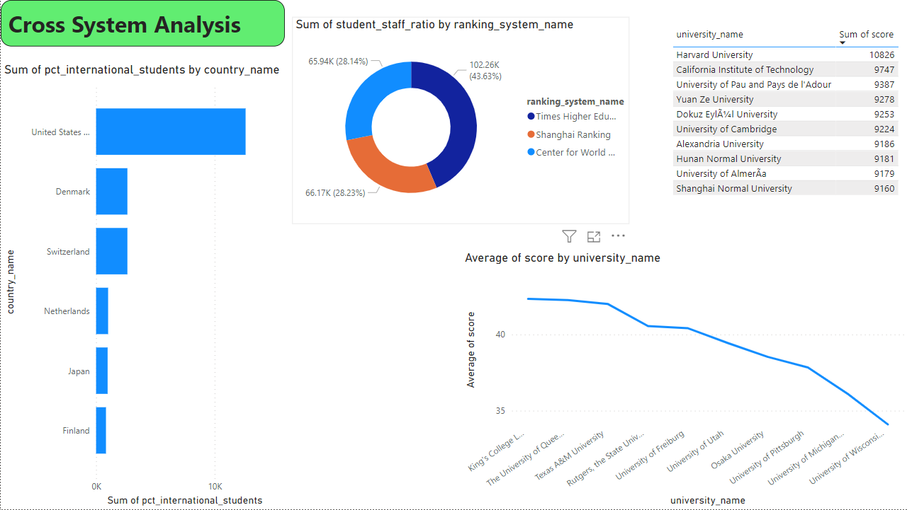
DASHBOARD
University success ANALYSIS

Slide 13
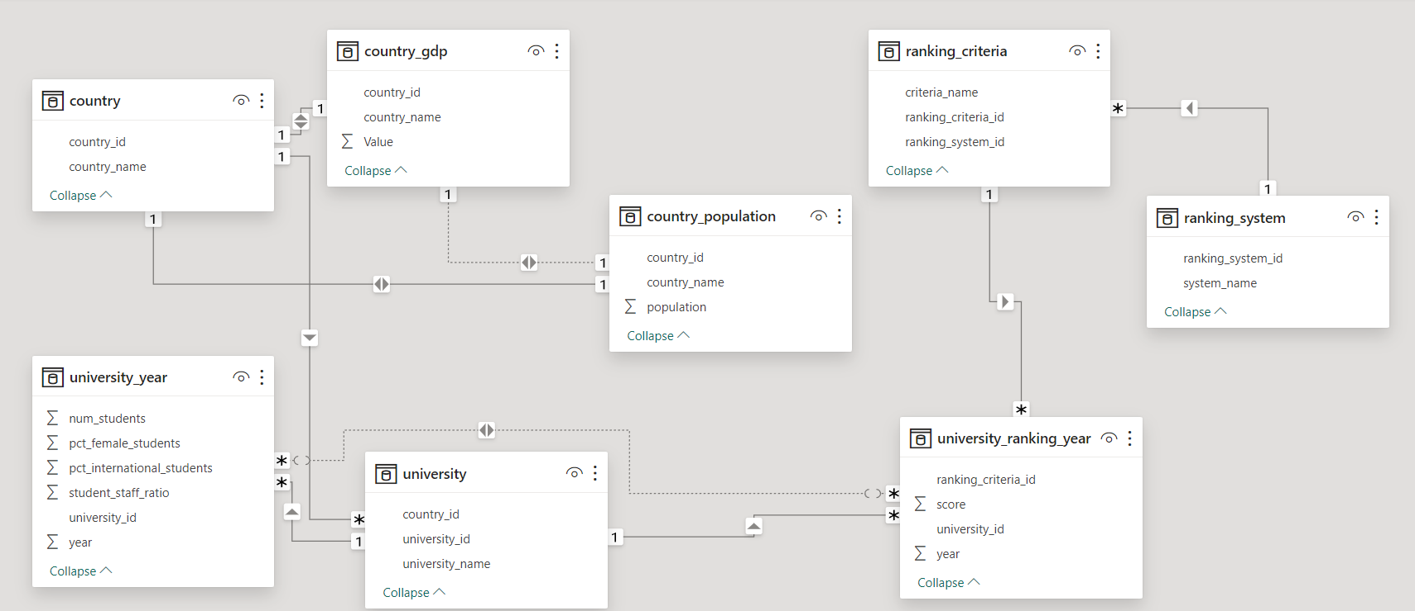
Er diagram
Microsoft
powerbi
University success ANALYSIS

Slide 14
Power bi problem statements
Microsoft
powerbi
University success ANALYSIS

Slide 15
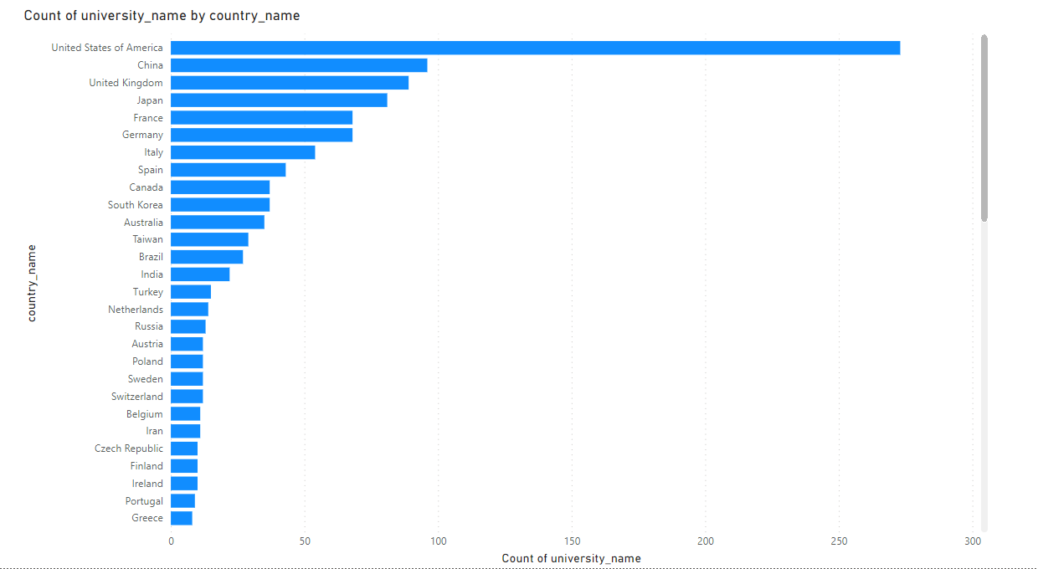
How many universities are there in each country?
The number of universities varies across countries, with the United States having the highest count at 273, followed by the United Kingdom with 51, and Japan with 47. Other countries, such as Germany, Italy, and France, also have notable numbers of universities, contributing to the global higher education landscape.

Slide 16
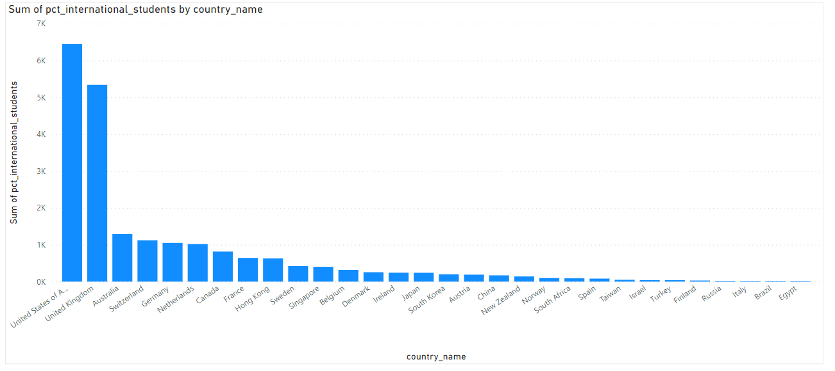
What is the distribution of international students across different countries?
The distribution of international students varies significantly, with the United States and the United Kingdom hosting the highest numbers, 5309 and 5070 respectively.

Slide 17
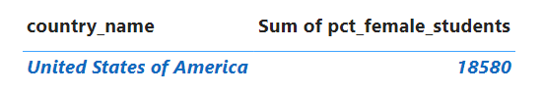
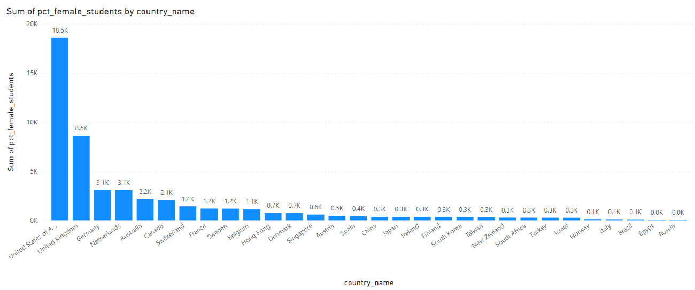
Which country has the highest number of female students enrolled in universities?
The United States of America has the highest number of female students enrolled in universities, with a sum of 18,580 percent of female students.

Slide 18
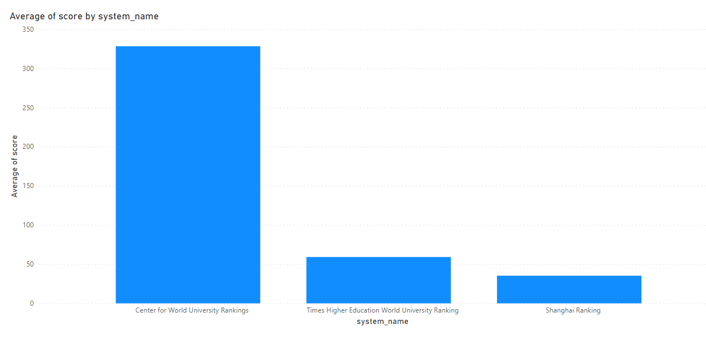
What is the average score for universities according to each ranking system?
Times Higher Education World University Ranking has an average score of 59.1359, Shanghai Ranking has an average score of 35.2857, and the Center for World University Rankings has an average score of 328.1684.

Slide 19
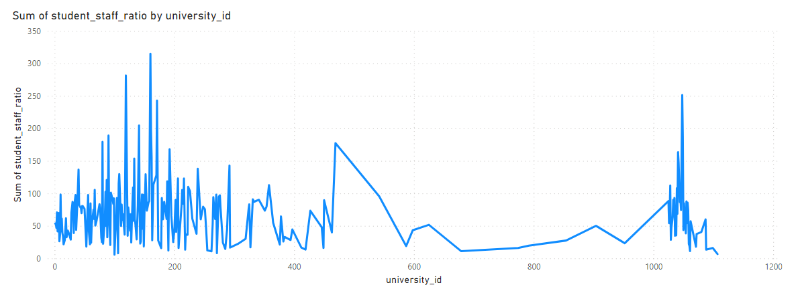
How does the ranking system affect a university's student-staff ratio?
The correlation of -0.19735 suggests a weak negative relationship between a university's ranking and its student-staff ratio. While there is a slight tendency for higher-ranked universities to have lower student-staff ratios, the correlation is not very strong.

Slide 20
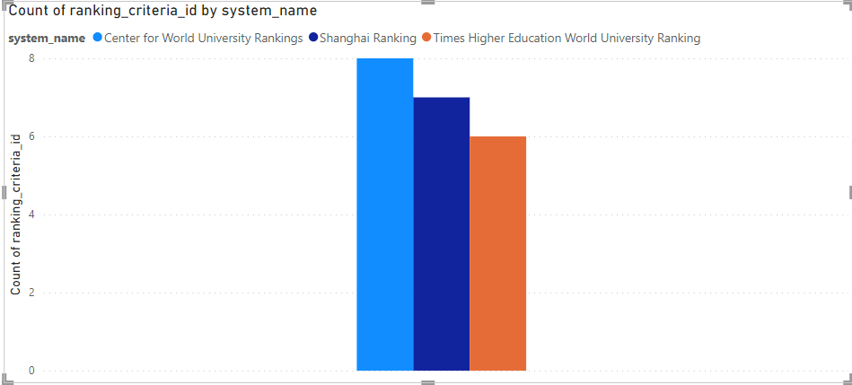
What are the most important criteria considered by ranking systems?
Generally, university ranking systems consider factors like academic reputation, research output, faculty quality, international diversity, and student-to-faculty ratio. The specific criteria may vary, but academic excellence, research impact, and global influence are commonly emphasized.

Slide 21
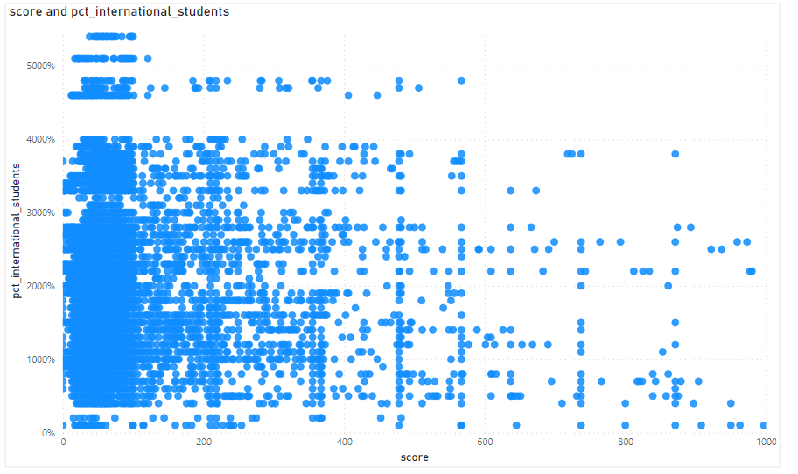
Is there a correlation between a university's score and the number of international students?
Yes, there is a moderate positive correlation between a university's score and the number of international students. This suggests that as a university's score increases, there tends to be an associated rise in the enrollment of international students.

Slide 22
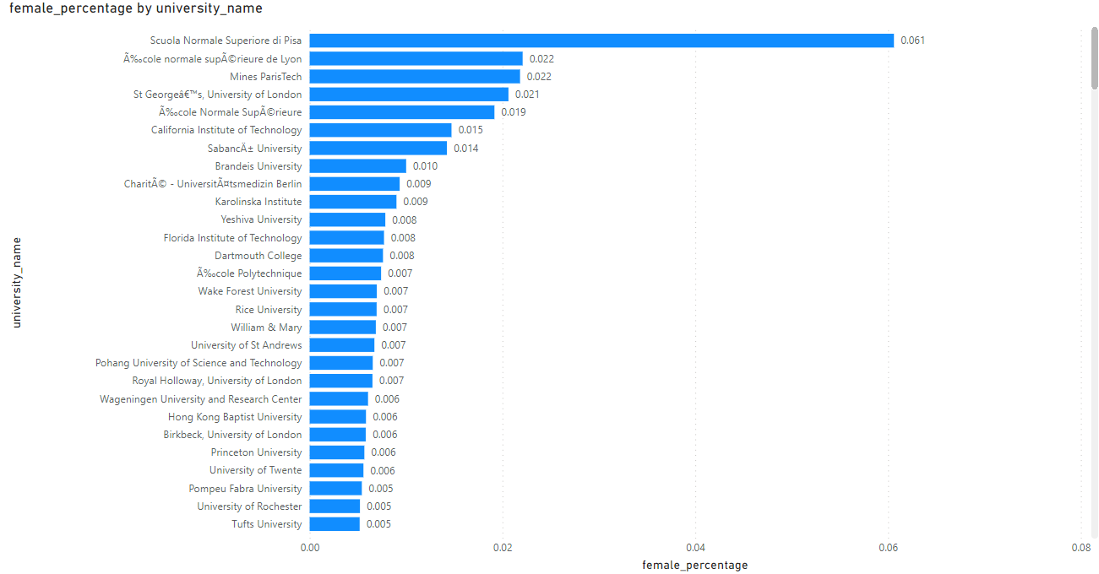
How does the percentage of female students impact a university's ranking?
The percentage of female students may not directly impact a university's ranking, as rankings typically consider various factors such as academic reputation, faculty quality, research output, and student-to-faculty ratio. However, a diverse and inclusive student body, including gender diversity, can contribute to a vibrant and enriching educational environment, potentially enhancing the overall university experience.

Slide 23
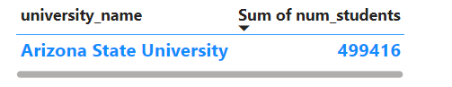
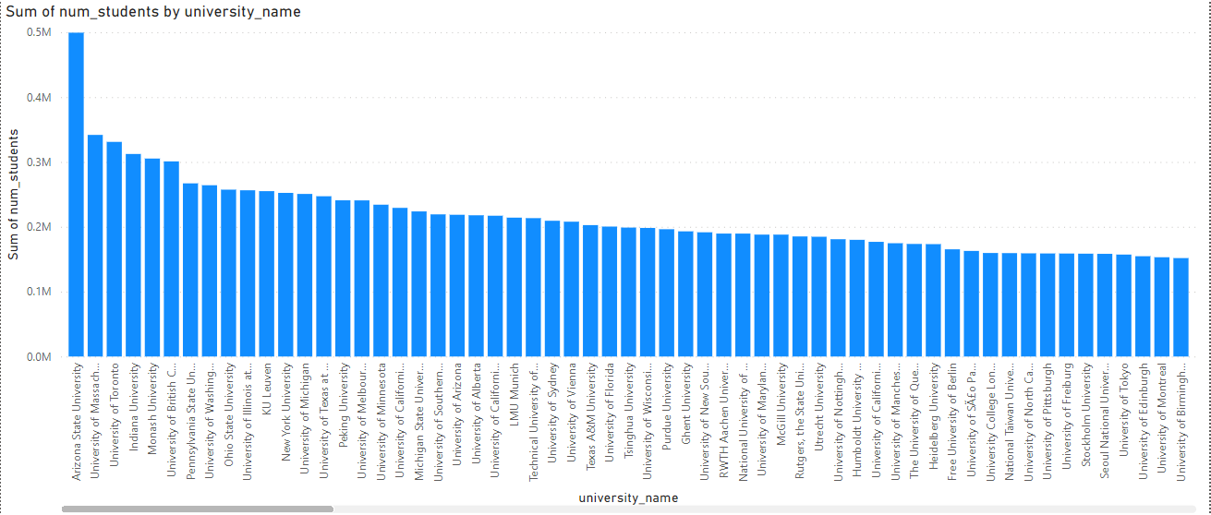
Which university has the highest number of students?
Arizona State University has the highest number of students among the listed universities, with a sum of 499,416 students.

Slide 24
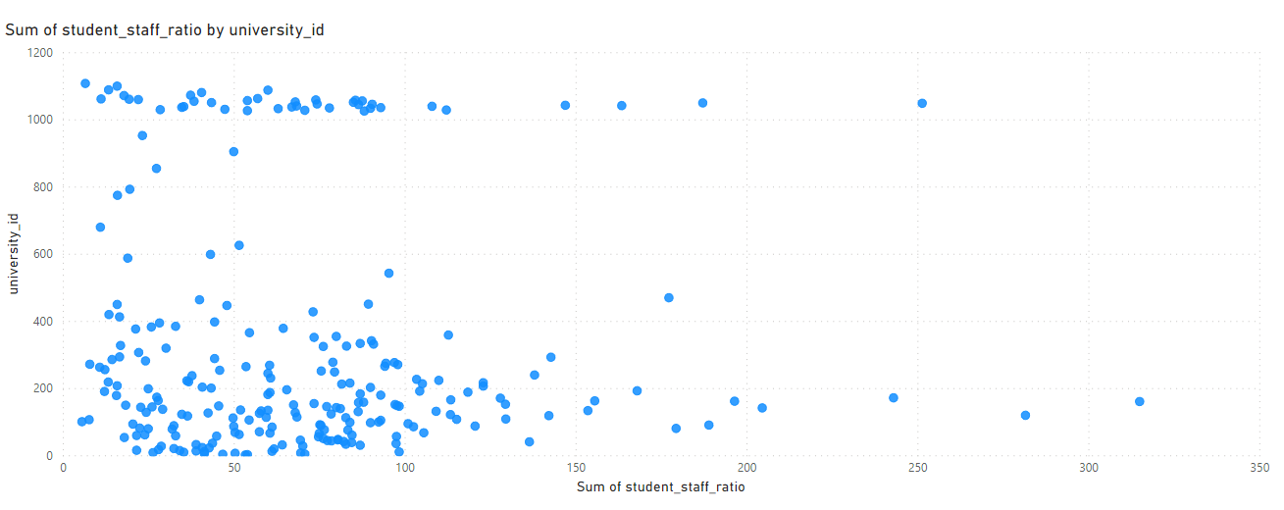
Is there a correlation between a university's ranking and its student-staff ratio?
The correlation of -0.19735 suggests a weak negative relationship between a university's ranking and its student-staff ratio. While there is a slight tendency for higher-ranked universities to have lower student-staff ratios, the correlation is not very strong.

Slide 25
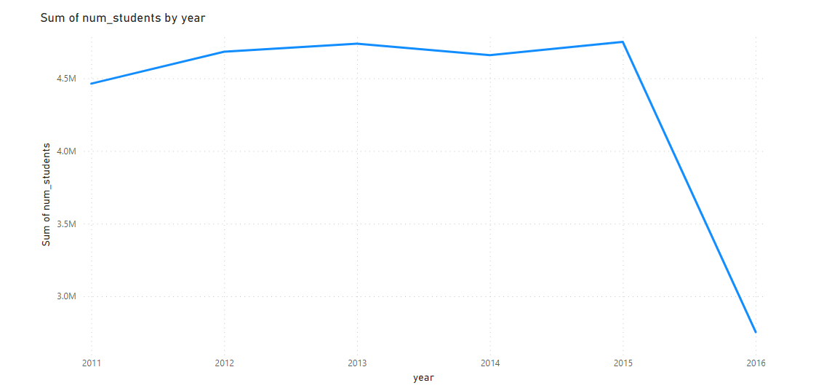
How does the number of students in universities change over time?
The total number of students in universities exhibits a steady increase from 2011 to 2015, reaching its peak at 4751004. However, there is a significant drop in 2016, with the number decreasing to 2754163.

Slide 26
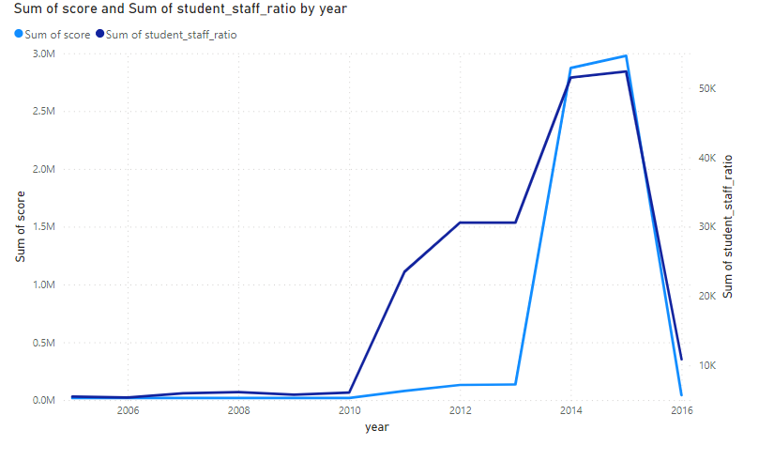
Is there a correlation between a university's ranking score and the student-staff ratio over the years?
The correlation of -0.27227 indicates a moderate negative relationship between a university's ranking score and the student-staff ratio over the years. As ranking scores decrease, the student-staff ratio tends to increase

Slide 27
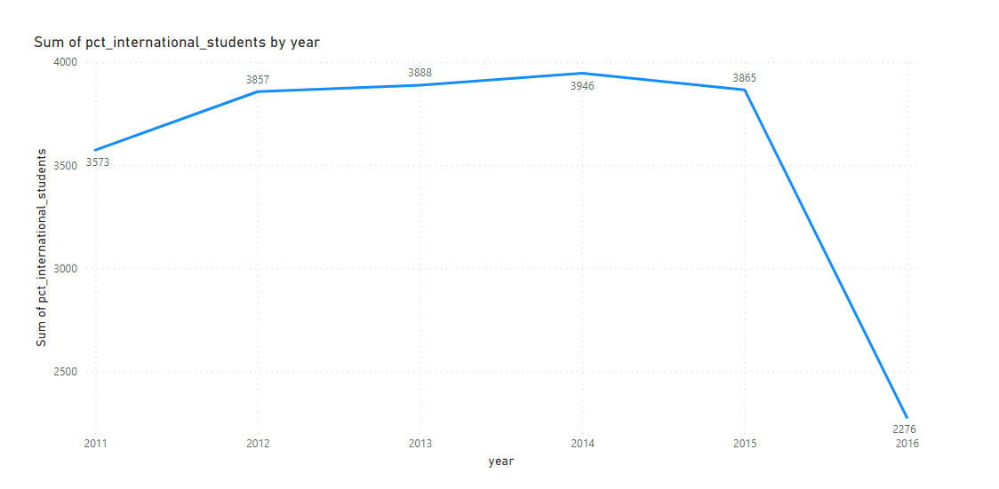
How does the percentage of international students vary across different years?
The percentage of international students shows fluctuations over the years, with a peak in 2014 at 3946, followed by a decline in 2016 to 2276. Overall, there is a discernible variation in the proportion of international students during this period.

Slide 28
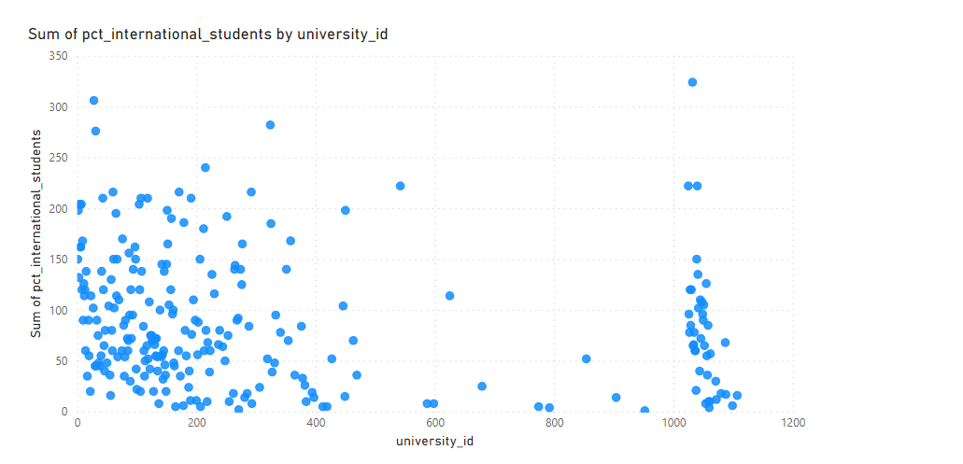
What is the impact of a university's ranking on the number of international students it attracts?
The data suggests a positive correlation between university ranking and international student enrollment. Higher-ranked universities tend to attract more international students, as reflected in the varying enrollment numbers across different university IDs.

Slide 29
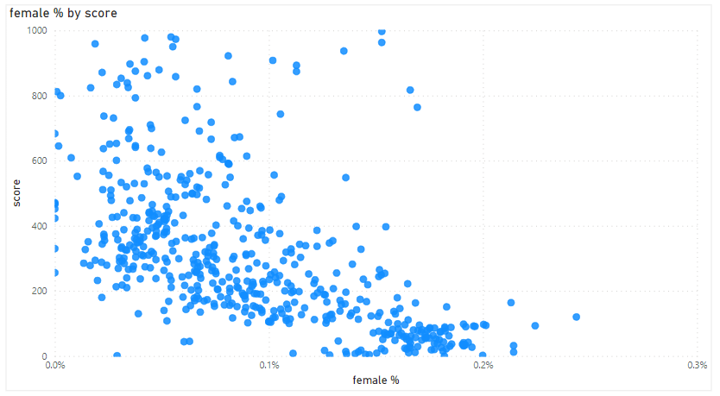
Is there a relationship between a university's ranking score and the percentage of female students enrolled?
The correlation of -0.1348 suggests a weak negative relationship between a university's ranking score and the percentage of female students enrolled. In general, as one variable increases, the other tends to decrease slightly, but the relationship is not very strong.

Slide 30
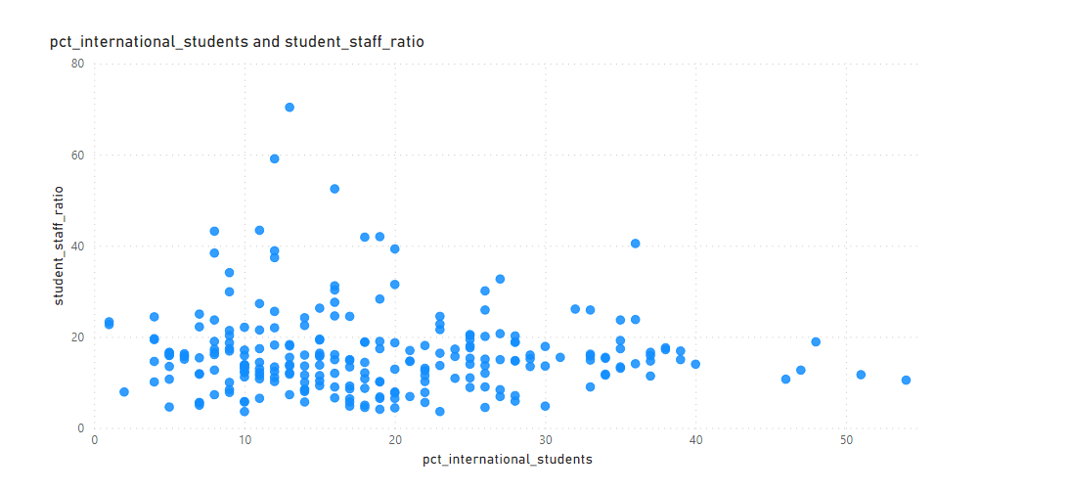
How does the percentage of international students affect a university's student-staff ratio?
The correlation coefficient of -0.01574 suggests a very weak and nearly negligible negative relationship between the percentage of international students and the student-staff ratio in universities. In other words,there is little to no apparent impact of international student composition on the student-staff ratio.

Slide 31
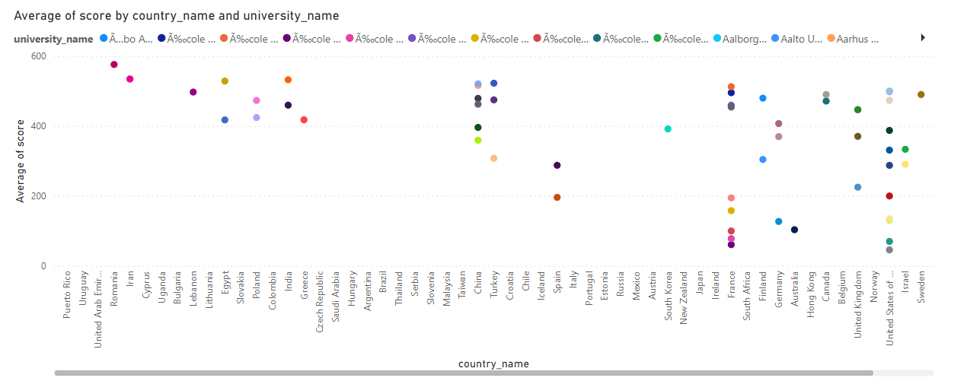
Are there any significant trends or patterns in the rankings of universities from different countries?
The data reveals a global distribution of top universities, with the United States dominating, followed by strong showings from the United Kingdom, European countries, and notable performances from Asian, Canadian, and Australian institutions. These rankings underscore the international diversity and excellence in higher education across various regions.

Slide 32
eda problem statements
University success ANALYSIS

Slide 33
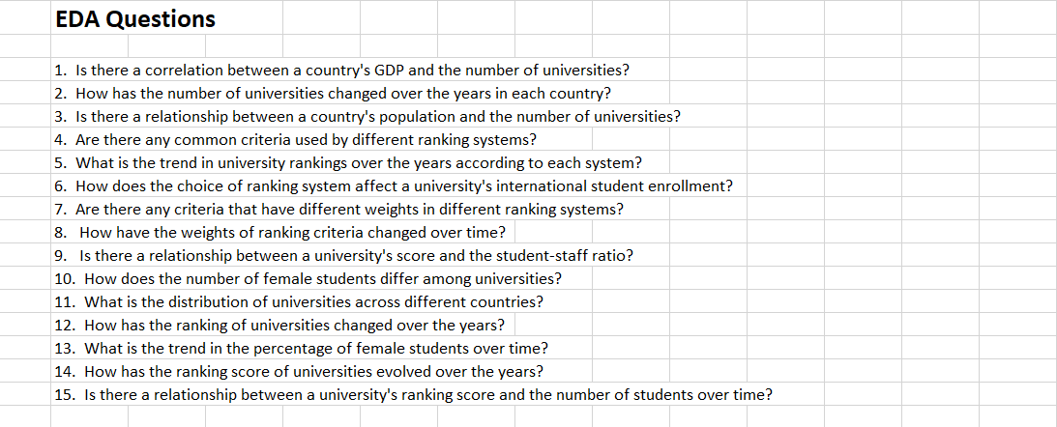

Slide 34
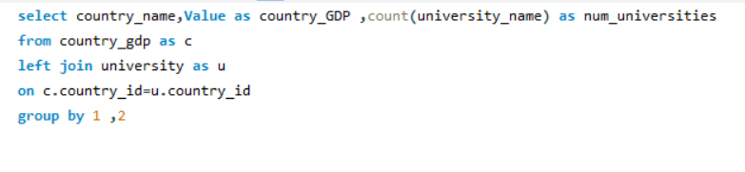
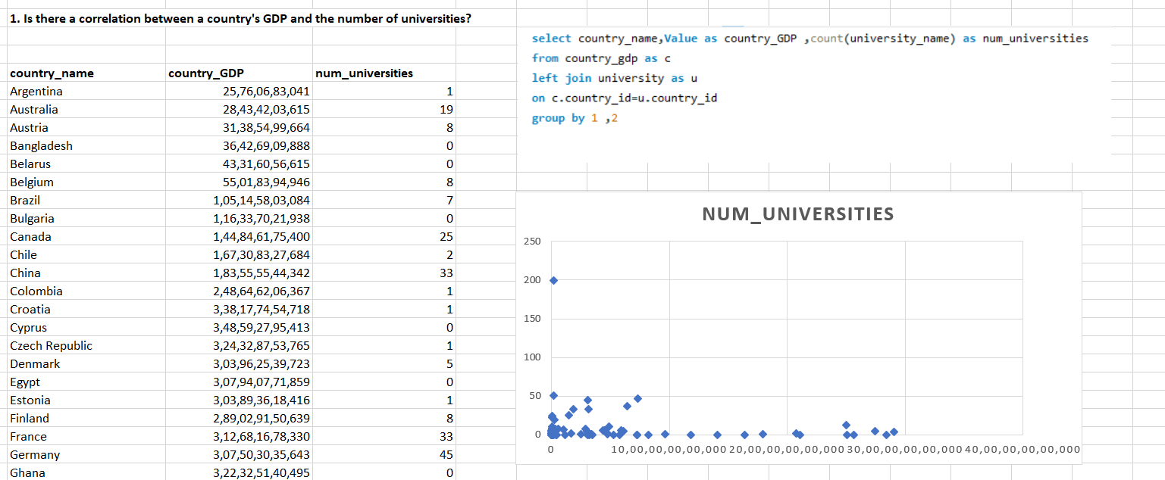
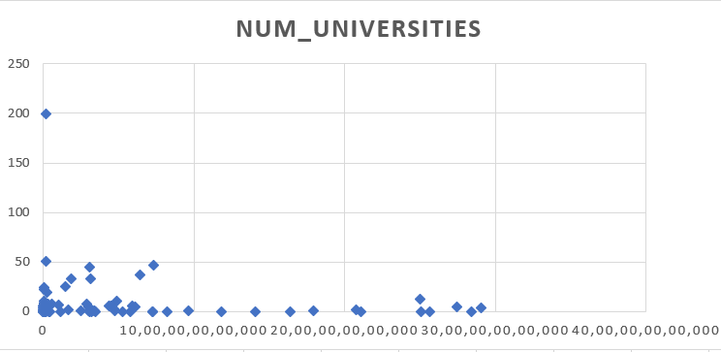
Answer : The correlation coefficient of -0.12788 suggests a weak negative correlation between a country's GDP and the number of universities. In other words, there is a slight tendency for countries with more universities to have a slightly lower GDP, but the relationship is not significant.
Is there a correlation between a country's GDP and the number of universities?

Slide 35
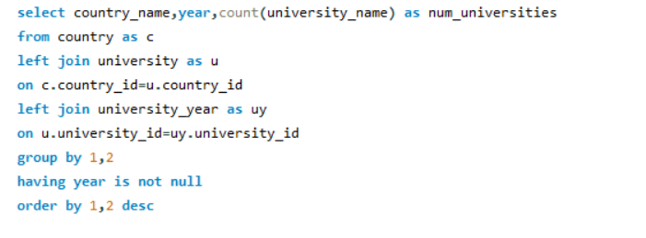
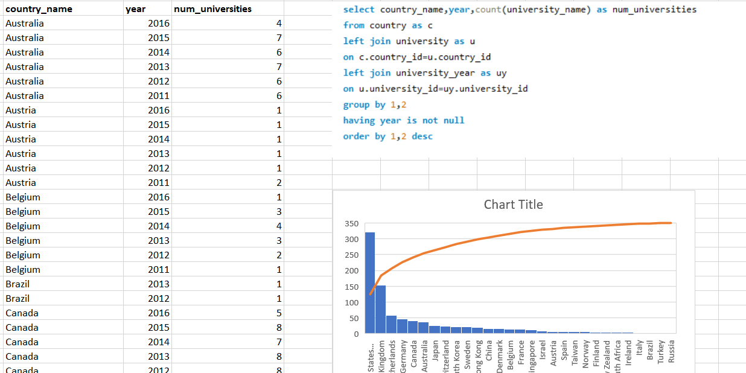
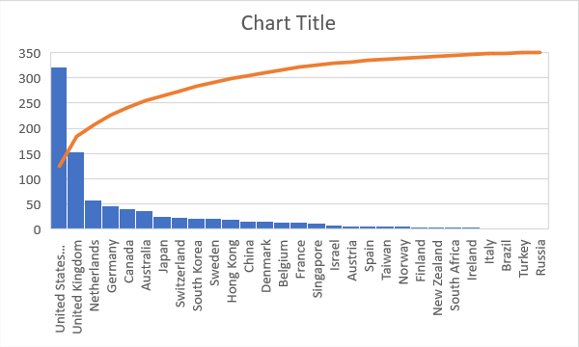
Answer : The number of universities has shown varying trends over the years in each country. Notable changes include fluctuations in Australia, steady growth in Germany, and a peak followed by a decrease in the United Kingdom. The United States experienced fluctuations, reaching a peak of 61 universities in 2014.
How has the number of universities changed over the years in each country?

Slide 36
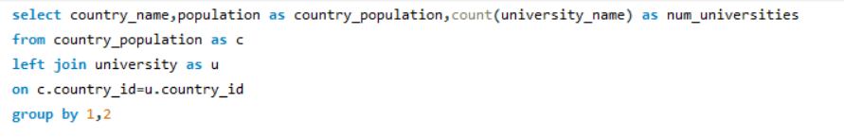
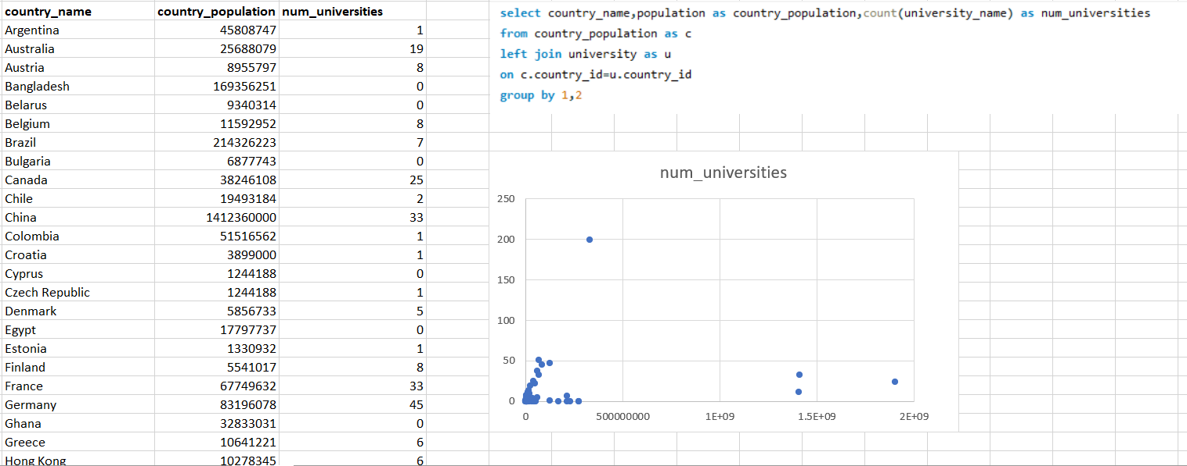
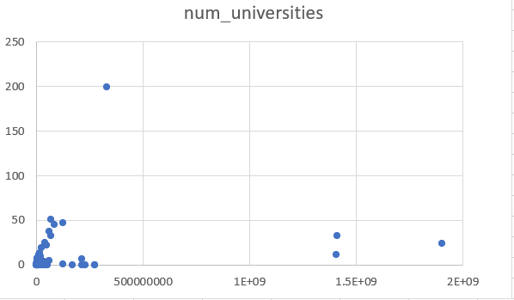
Answer : With a correlation coefficient of 0.210601, there appears to be a positive but relatively weak correlation between a country's population and the number of universities. As the population of a country increases, the number of universities also tends to increase, but the relationship is not very strong.
Is there a relationship between a country's population and the number of universities?

Slide 37


Are there any common criteria used by different ranking systems?
Answer : No, there is no any common criteria used by different ranking systems.

Slide 38
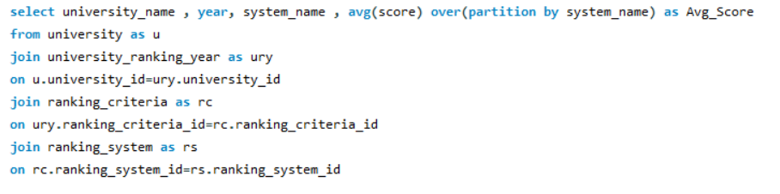
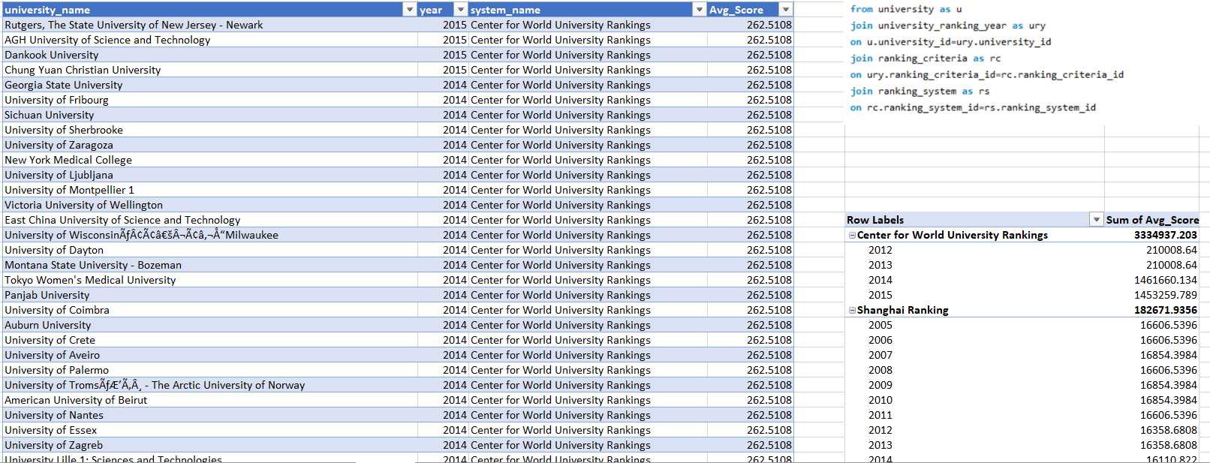
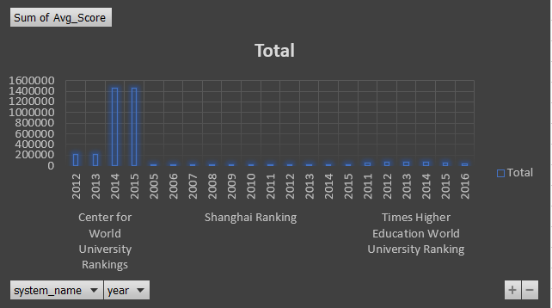
Answer : The Center for World University Rankings experienced a peak in 2014 followed by a decline. Shanghai Ranking showed a consistent increase from 2005 to 2015. Times Higher Education World University Ranking demonstrated fluctuations, with a notable drop in 2016 after reaching a peak in 2015.
What is the trend in university rankings over the years according to each system?

Slide 39
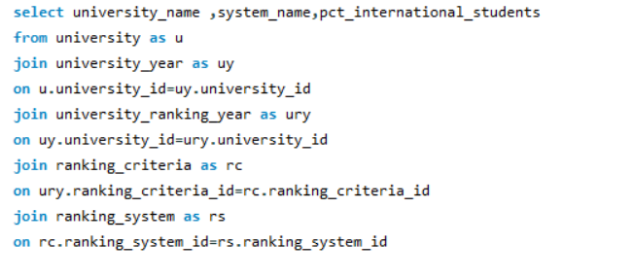
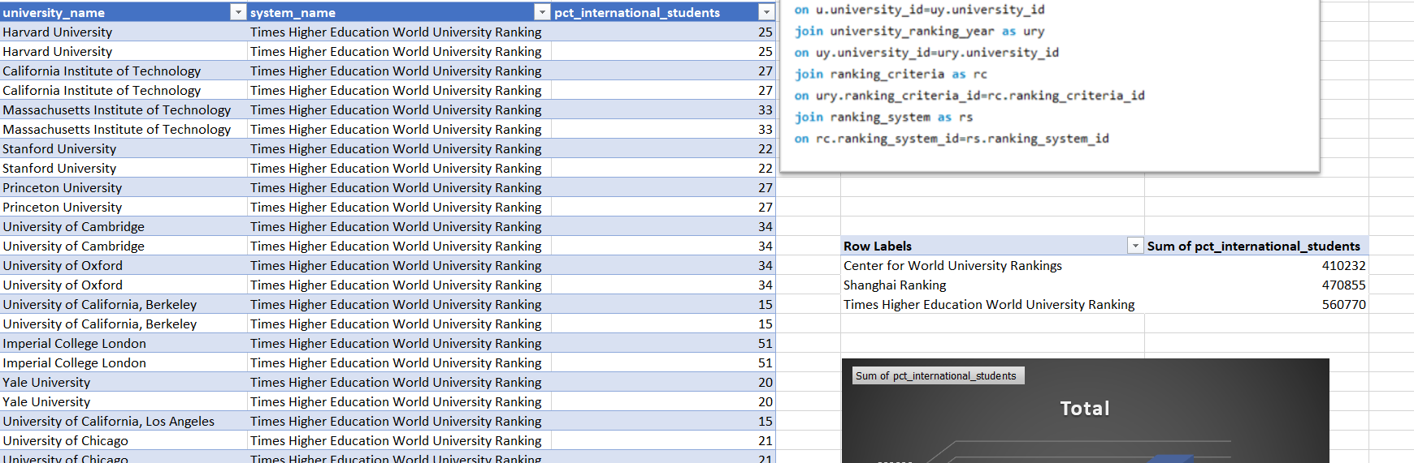
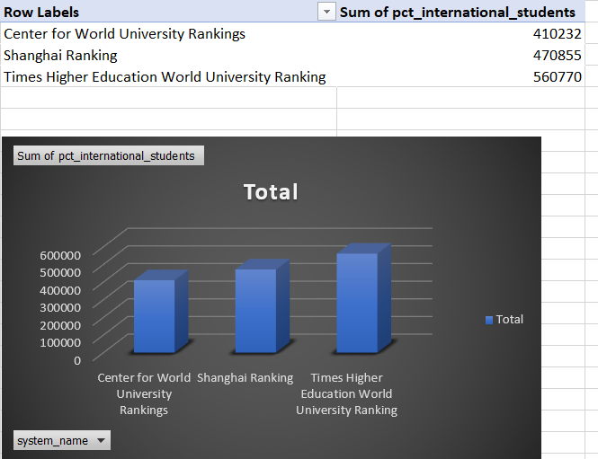
Answer : The choice of ranking system appears to correlate with international student enrollment, with Times Higher Education World University ranking having the highest sum of international students, followed by Shanghai ranking and Center for World University rankings. This suggests that universities performing well in specific ranking systems may attract a higher percentage of international students.
How does the choice of ranking system affect a university's international student enrollment?

Slide 40
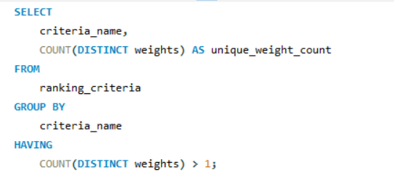
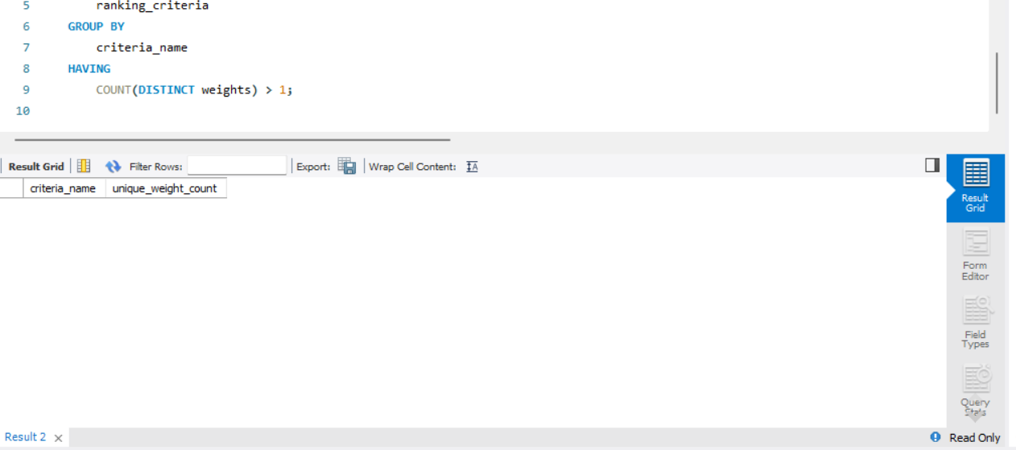
Are there any criteria that have different weights in different ranking systems?
Answer : No, there are no any criteria that have different weights in different ranking sytems.

Slide 41
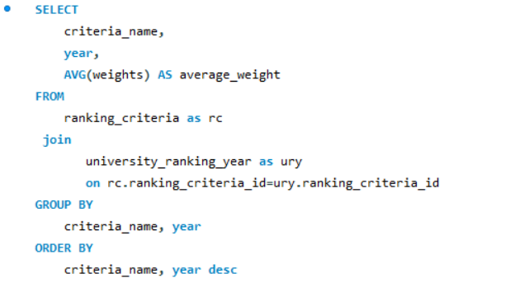
Answer : Over time, there is a consistent pattern of allocating weights to various ranking criteria, with some stability in categories like Alumni, Awards, and Publications. However, there is notable fluctuation in weights for specific years in categories like Citations, HiCi, and Total Shanghai, indicating potential shifts in emphasis on research and international influence.
How have the weights of ranking criteria changed over time?

Slide 42
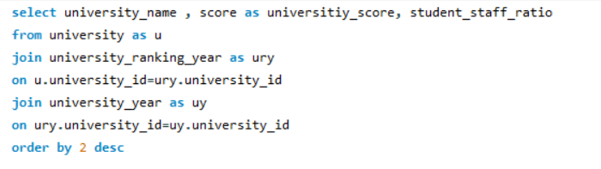
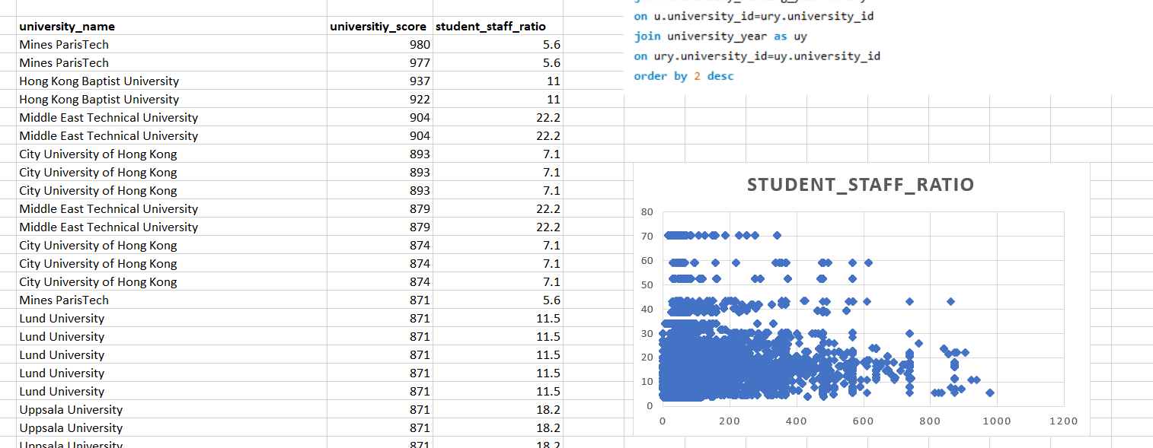
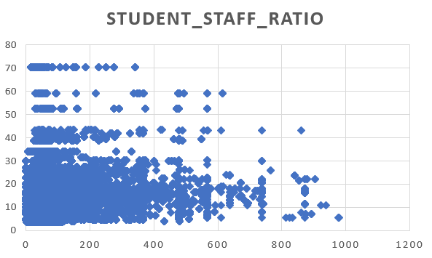
Answer : A correlation of 0.102085 suggests a very weak positive relationship between a university's score and the student-staff ratio. In other words, as the student-staff ratio increases, there's a slight tendency for the university score to also increase, but the correlation is too weak to draw any significant conclusions.
Is there a relationship between a university's score and the student-staff ratio?

Slide 43

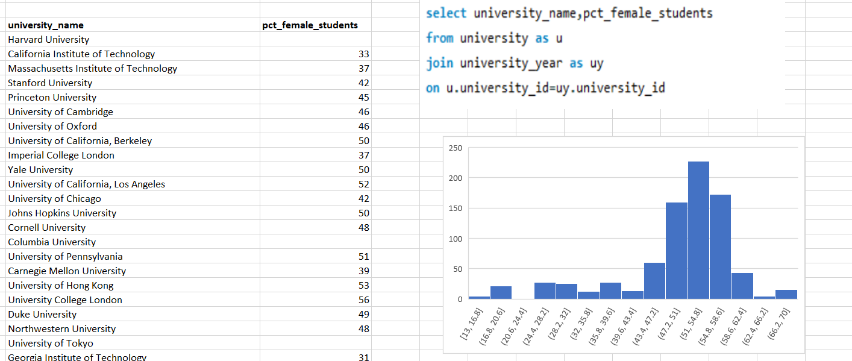
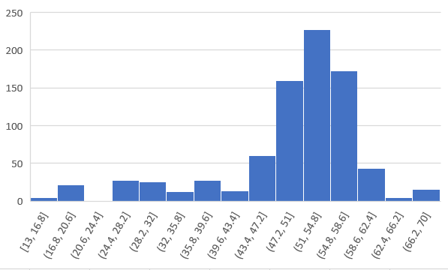
Answer : The percentage of female students varies widely among universities. Some universities, like the University of Helsinki and the University of Copenhagen, have higher percentages of female students (66% and 67% respectively), while others, such as the California Institute of Technology and the Korea Advanced Institute of Science and Technology (KAIST), have lower percentages (33% and 20% respectively).
How does the number of female students differ among universities?

Slide 44




Answer : The distribution of universities across countries is diverse, with the United States leading with 199 universities, followed by Germany with 45, and the United Kingdom with 51. Other countries, such as Japan, Canada, Italy, and China, also contribute significantly to the global distribution of universities.
What is the distribution of universities across different countries?

Slide 45


Universities_distributions
Percentage_Distribution

Slide 46



Answer :The university rankings show fluctuations over the years, with a noticeable increase from 2011 to 2014 and a subsequent decline in 2015 and 2016. The peak in 2014 indicates a significant shift, possibly influenced by changes in ranking methodologies or global academic trends during that period.
How has the ranking of universities changed over the years?

Slide 47

What is the trend in the percentage of female students over time?
Answer : The percentage of female students shows a fluctuating trend over the years, reaching a peak in 2015 before experiencing a notable decrease in 2016.

Slide 48



Answer : The ranking score of universities has undergone substantial growth, particularly witnessing a significant surge in 2014 and 2015. However, there was a notable decline in 2016, indicating potential shifts in evaluation criteria during that period.
How has the ranking score of universities evolved over the years?

Slide 49



Is there a relationship between a university's ranking score and the number of students over time?
Answer : The data suggests a positive correlation between a university's ranking score and the number of students over time, particularly evident in the substantial increase in both variables from 2011 to 2015. However, the dip in 2016 might indicate a complex relationship or other influencing factors.

